Slide 1
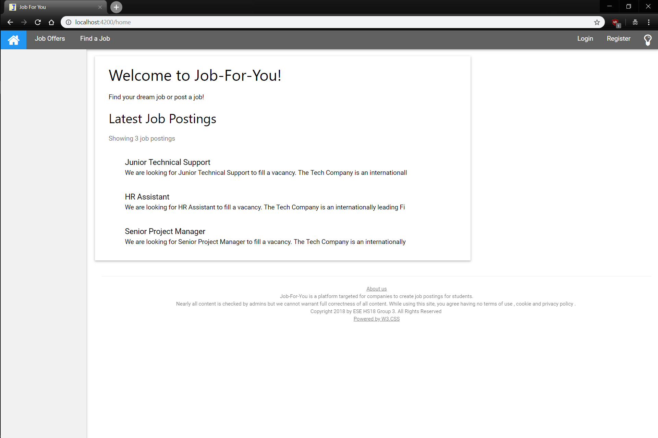
Redundant links / messages will not be displayed on subsequent pages
Redirect to ‘Home’, Job Offers or Find a Job (Search)
Login / Register lead to respective components. Lightbulb (on click) changes to night theme
Clicking on a job leads to details for that job
Redirect to About Us Page

Slide 2
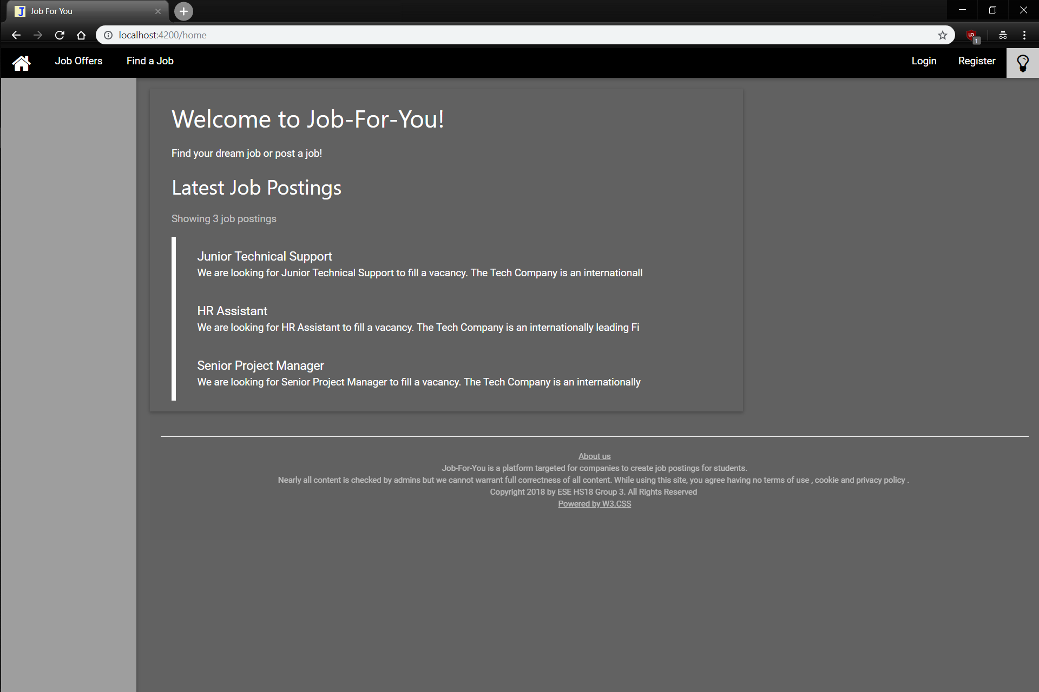

Slide 3
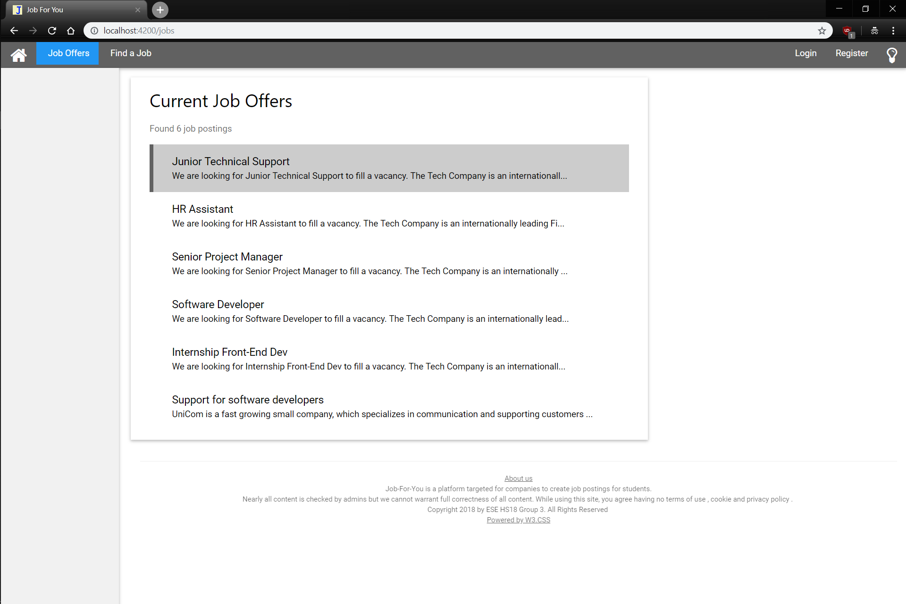

Clicking on a job leads to details for that job, the job where the mouse hovers has a highlight

Slide 4
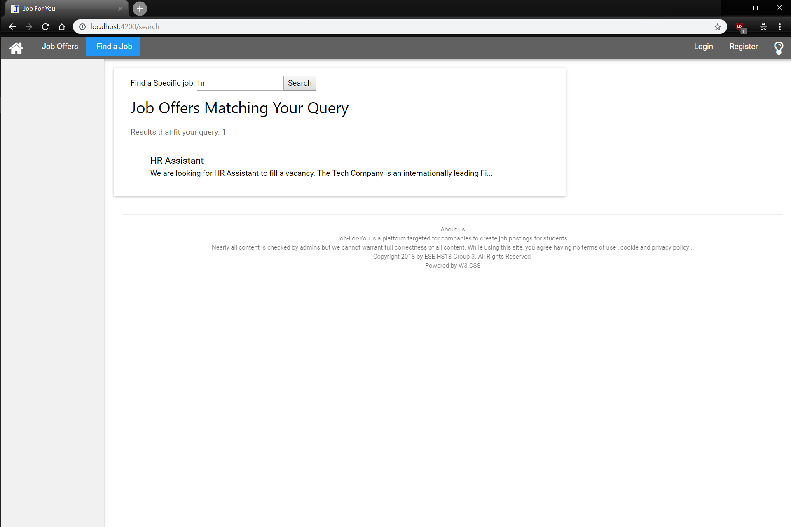
Entering a search term and pressing ‘Enter’ or the Search button searches job titles for matches

Slide 5
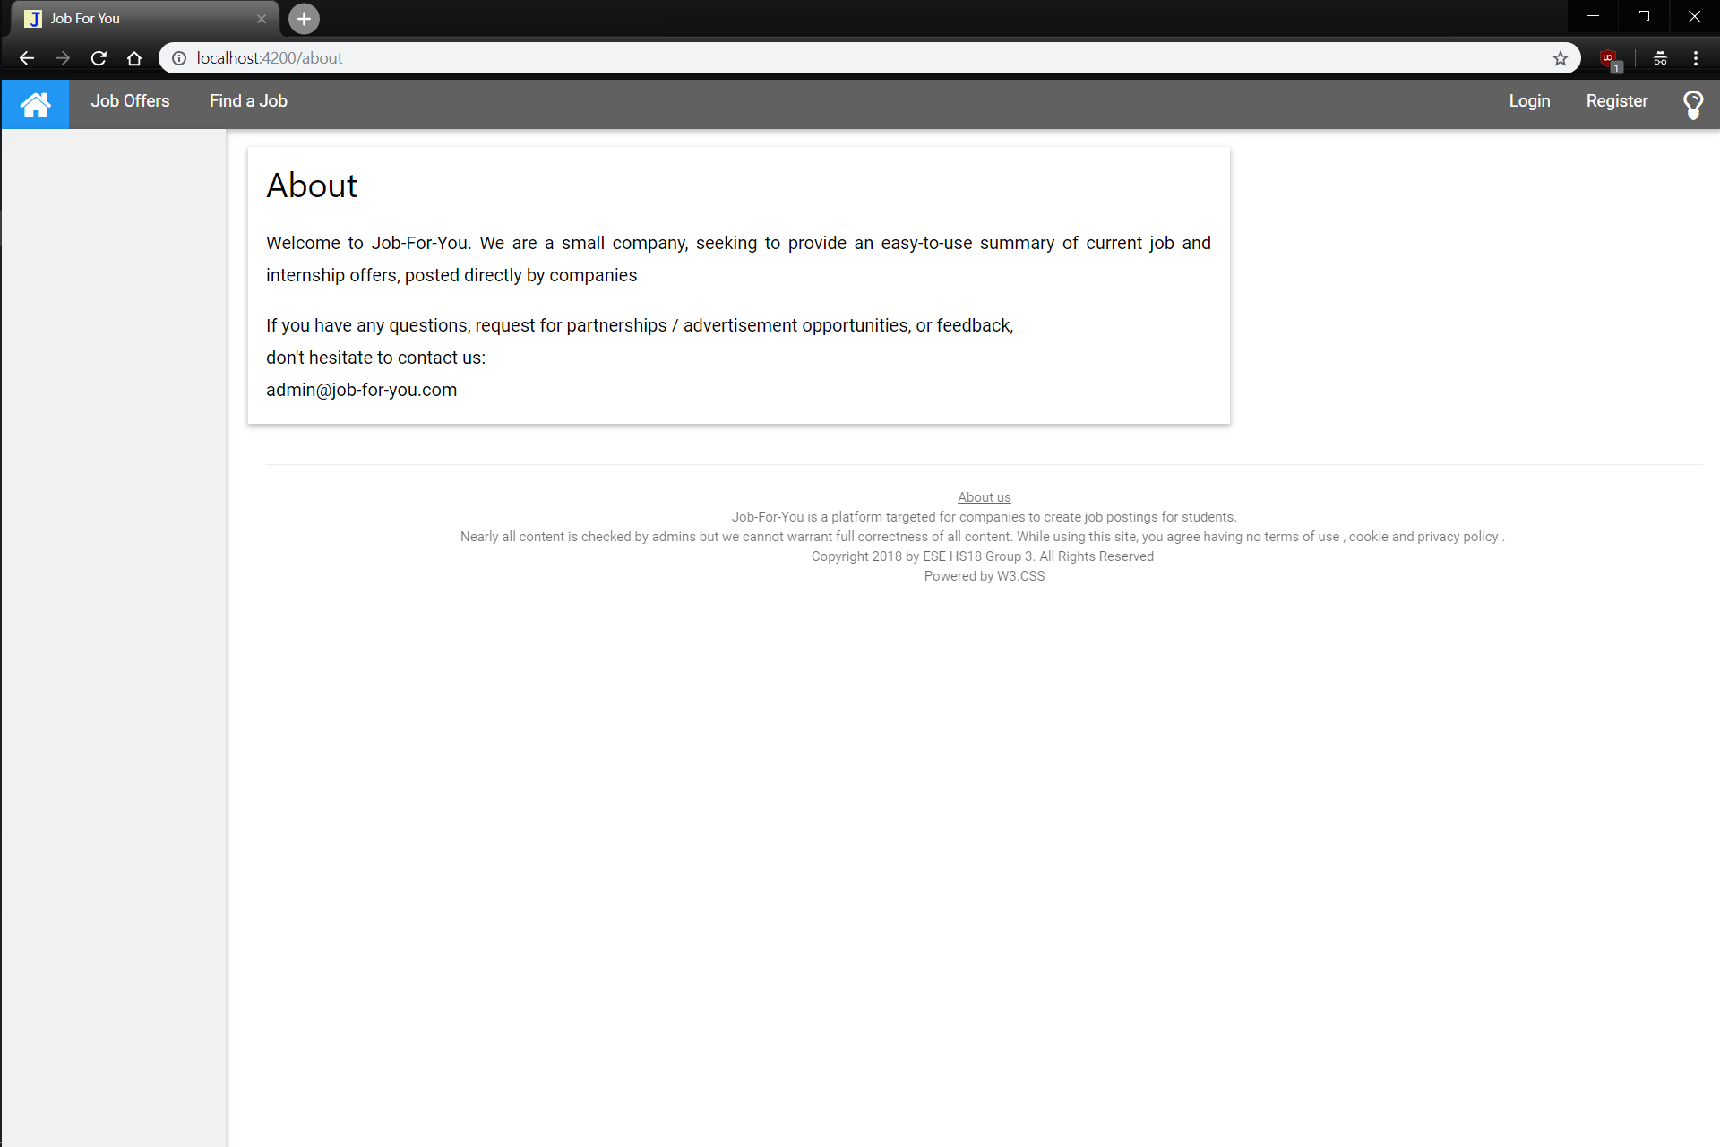
Entering a search term and pressing ‘Enter’ or the Search button searches job titles for matches
No additional comments needed

Slide 6
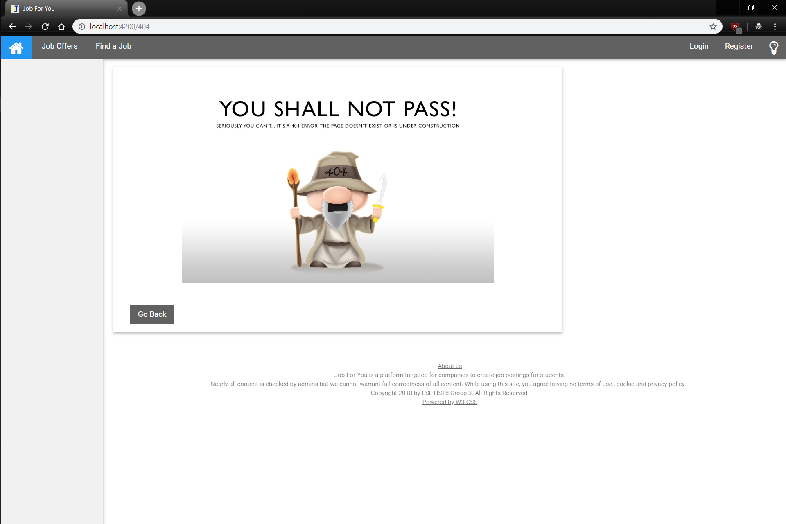
Entering / clicking any invalid URL redirects here
Redirects to the last visited page

